Slide 1
Chapter 5: Forces
Grade 8
Physics

Slide 2
Classification of Forces
There are two types of forces
Non – contact forces OR
Action – at – a- distance force
Contact Forces

Slide 3
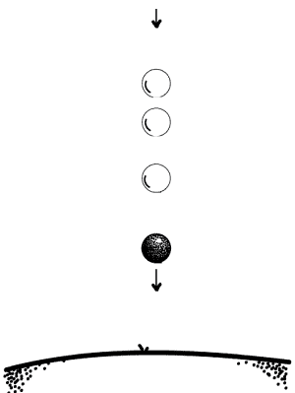
Gravitational Force / Weight
A ball is dropped without initial speed falls on the ground.
The ball fell due to gravity.
Gravitational force is a non-contact force.

Slide 4
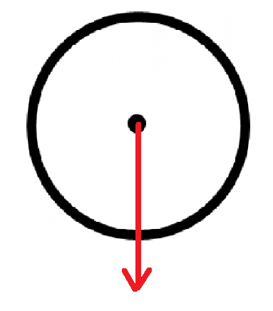
Gravitational Force / Weight
Weight is applied to the center of gravity of the object.
Its line of action is vertical, and its direction is downward.

Slide 5
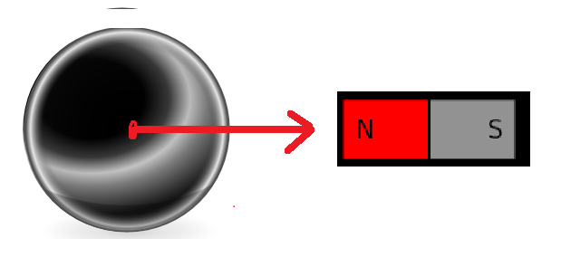
Magnetic Force
The magnet exerts a force on the steel ball.
Magnetic force is a non-contact force.

Slide 6
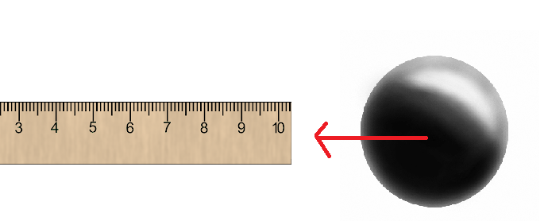
Electric Force
A plexiglass ruler is rubbed with a woolen fabric. It is close to a very light ball without touching it.
The electrified ruler exerts a force on the ball.
This electric force is non-contact.

Slide 7
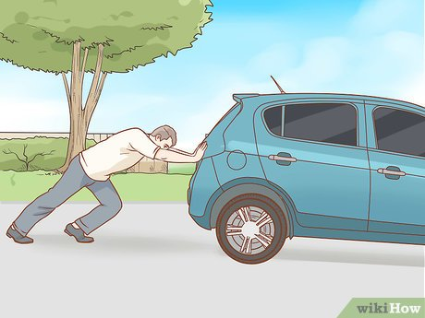
Pushing Force
A man is pushing the car with his hands in order to move it.
This force wouldn’t be exerted if there was no contact (touch) between the man and the car.
This pushing force is a contact force.

Slide 8
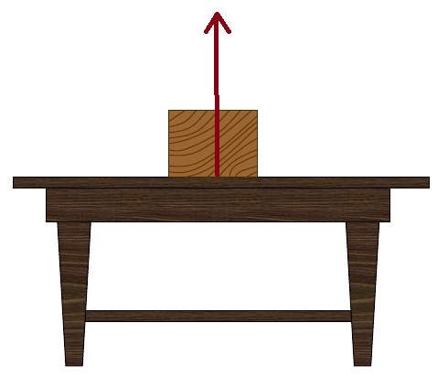
Reaction of Support
A block is placed on a horizontal table. The table exerts an upward force on the block to prevent it from falling.
This force will not exist if there was no contact between the block and table.
Normal reaction of support is a contact force.

Slide 9
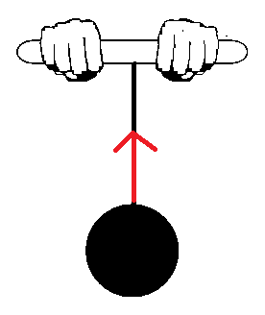
Tension of a String
A ball is suspended from the free end of a string. The string exerts a force on the ball to prevent it from falling.
If the spring is cut, the force will not exist.
Tension is a contact force.

Slide 10
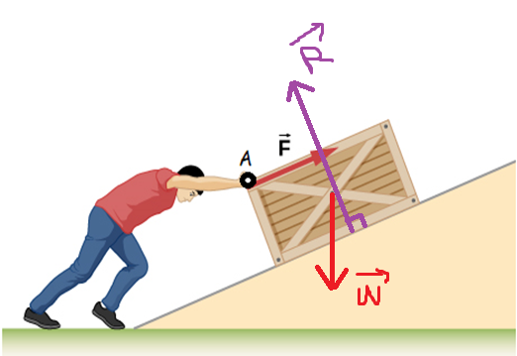
Forces acting on the wooden crate:
Pushing force $\vec{F}$
It is a contact force.
Its point of application is A / line of action: oblique/ direction: upward to the right
Normal reaction of support $\vec{R}$:
It is a contact force.
Its point of application is point of contact between the wooden crate and the surface (inclined plane) / line of action: oblique and perpendicular to the surface/ direction: upward
Gravitational force $\vec{W}$:
It is an action-at-a-distance force
Its point of application is center of gravity/ line of action: vertical/ direction: downward

Slide 11
Summary
Action-at-a-distance Forces
Gravitational Force
Electric Force
Contact Forces
Pushing force
Tension
Magnetic Force
Reaction of support

Slide 12
Force of Friction
A book is pushed with a certain speed on a rough and horizontal table.
The table exerts a force on the book in an opposite direction of its movement to stop it.
The table and book are in contact.
Friction is a contact force.

Slide 13
Notes:
The force of friction exists only on a rough surface.
There is no friction (negligible friction) on a smooth surface/support.
The force of friction opposes the motion of the body.
The force of friction is sometimes useful and sometimes harmful.
Check examples p.94-95

